Slide 1
Hangman Game
Tetiana Drai
Contact: tetiana.drai@gmail.com

Slide 2
Why did I choose this project?
I've always wanted to write a game.
This game makes it easy to fulfil all the requirements for the project. The requirements were including the use of:
Function
Object
Array
External API
DOM

Slide 3
Let's look at some examples

Slide 4
The function is used to start the game
function startGame() {
…
}

Slide 5
The main variables are part of the elements object
const elements = {
lives: document.querySelector(".lives b"),
keyboard:document.querySelector(".alphabet"),
hangmanImg: document.querySelector(".hangmanBox img"),
alphabet: ["A","B","C","D","E","F","G","H","I","J","K","L",
"M","N","O","P","Q","R","S","T","U","V","W","X","Y","Z"],
}

Slide 6
Array “alphabet” was used to create keyboard with for cycle
const elements = {···
alphabet: ["A","B","C","D","E","F","G","H","I","J","K","L",
"M","N","O","P","Q","R","S","T","U","V","W","X","Y","Z"],
}
···
for (let i = 0; i <= elements.alphabet.length - 1; i++) {
const button = document.createElement("button");
button.innerText = elements.alphabet[i];
elements.keyboard.appendChild(button);
button.addEventListener("click", e=> initGame(e.target, String.fromCharCode(i) ));
}

Slide 7
We are using API call to get a random word for a round
const api = "https://random-word-api.herokuapp.com/word"
fetch(api)
.then((response) => response.json())
.then((response) => {
word = response?.[0] || 'graal';
correctLetter = word;
document.title = word;
console.log(word);
});

Slide 8
Using the DOM we deactivate the pressed buttons
button.setAttribute('disabled', true);

Slide 9
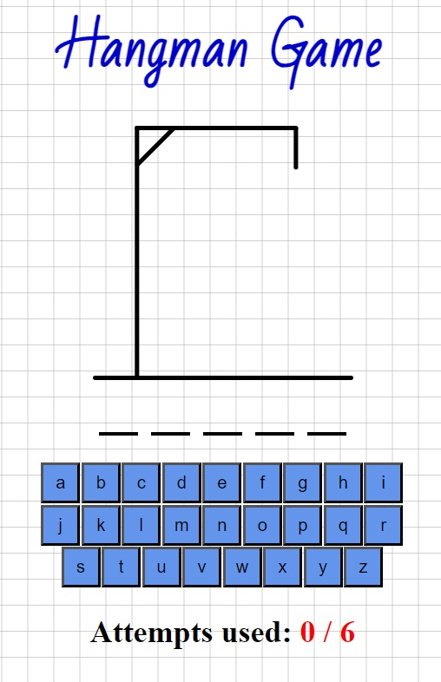
How it works?
The user is asked to guess the word
There are 6 attempts for each word

Slide 10
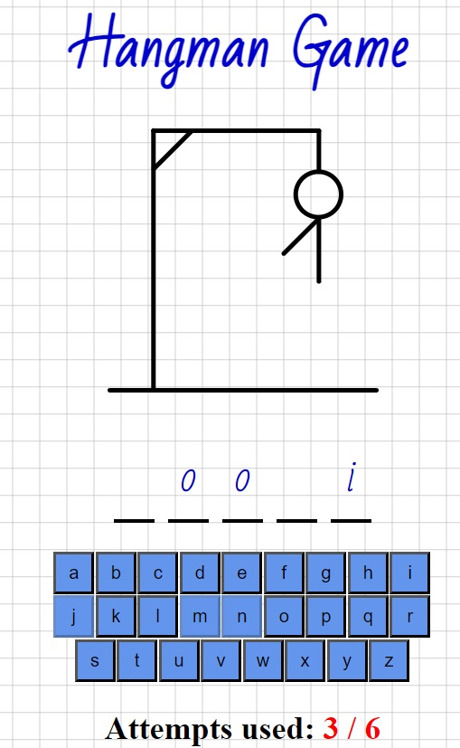
The guessed letter appears on the screen.
If the player indicates the wrong letter (made a mistake), a detail of a gallows is drawn on the screen
By clicking on the letter it is deactivated so that the user can see the previously selected letters

Slide 11
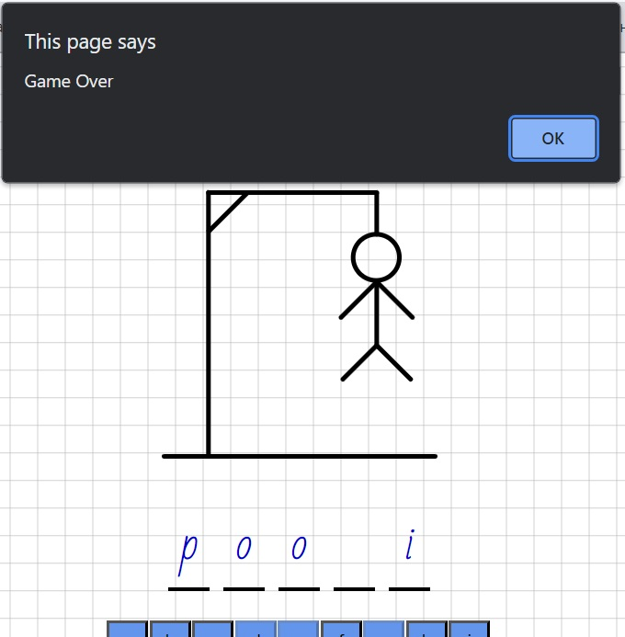
At the end of the game the user will see a notification about losing or winning
When the OK button is pressed in the notification window, the game starts again
If the API does not work, the word "graal" is displayed by default

Slide 12
Problems
Availability of the necessary APIs.
Lack of hints for the player.
Search for own errors in the code.

Slide 13
Further update
API Replacement. This will give the ability to give hints, which will improve and facilitate the process of the game.
Ability to enter letters through the keyboard.
Ability to enter a user nickname to create a tournament table.

Slide 14
Thank you for your attention!
Contact
Tetiana Drai tetiana.drai@gmail.com

